Slide 1
Internet 协议栈

Slide 2
Protocol “Layers”
Networks are complex!
many “pieces”:
hosts
routers
links of various media
applications
protocols
hardware, software
Question:
Is there any hope of organizing structure of network?
Or at least our discussion of networks?

Slide 3
Organization of air travel
ticket (purchase)
baggage (check)
gates (load)
runway takeoff
airplane routing
ticket (complain)
baggage (claim)
gates (unload)
runway landing
airplane routing
airplane routing
a series of steps

Slide 4
Layering of airline functionality
ticket (purchase)
baggage (check)
gates (load)
runway (takeoff)
airplane routing
ticket (complain)
baggage (claim
gates (unload)
runway (land)
airplane routing
ticket
baggage
gate
takeoff/landing
airplane routing
airplane routing
airplane routing
departure
airport
intermediate air-traffic
control centers
arrival
airport
Layers: each layer implements a service
via its own internal-layer actions
relying on services provided by layer below

Slide 5
Why layering?
Dealing with complex systems:
explicit structure allows identification, relationship of complex system’s pieces
layered reference model for discussion
modularization eases maintenance, updating of system
change of implementation of layer’s service transparent to rest of system
e.g., change in gate procedure doesn’t affect rest of system
layering considered harmful?

Slide 6
Internet protocol stack
application: supporting network applications
FTP, SMTP, HTTP
transport: process-process data transfer
TCP, UDP
network: routing of datagrams from source to destination
IP, routing protocols
link: data transfer between neighboring network elements
PPP, Ethernet
physical: bits “on the wire”
application
transport
network
link
physical

Slide 7
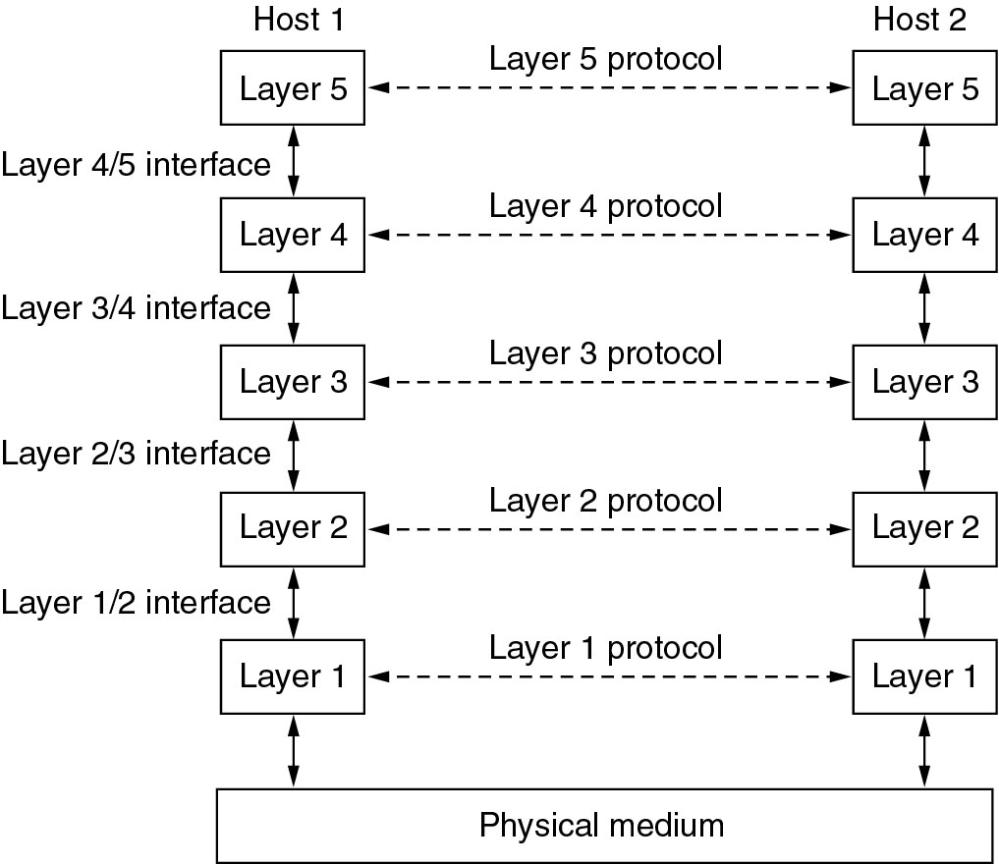
Protocol Hierarchies
Layers, protocols, and interfaces

Slide 8
ISO/OSI reference model
presentation: allow applications to interpret meaning of data, e.g., encryption, compression, machine-specific conventions
session: synchronization, checkpointing, recovery of data exchange
Internet stack “missing” these layers!
these services, if needed, must be implemented in application
needed?
application
presentation
session
transport
network
link
physical

Slide 9
A Critique of the OSI Model and
Why OSI did not take over the world
Bad timing
Bad technology
Bad implementations
Bad politics

Slide 10
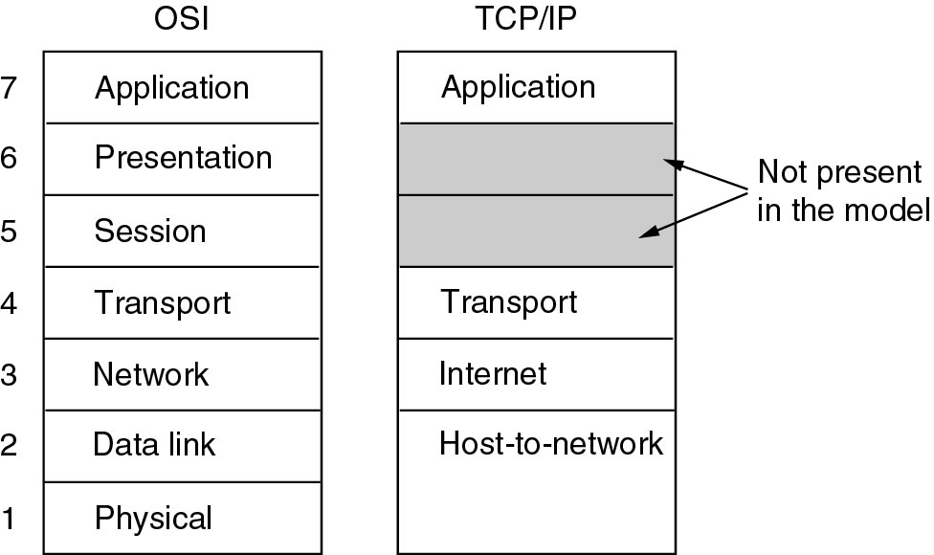
TCP/IP RM

Slide 11
A Critique of the TCP/IP Reference Model
Problems:
Service, interface, and protocol not distinguished
Not a general model
Host-to-network “layer” not really a layer
No mention of physical and data link layers
Minor protocols deeply entrenched, hard to replace

Slide 12
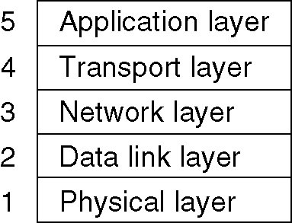
Hybrid Model
TCP/IP Model: Five-layer structure
Internet protocol stack
The hybrid reference model to be used in this book.

Slide 13
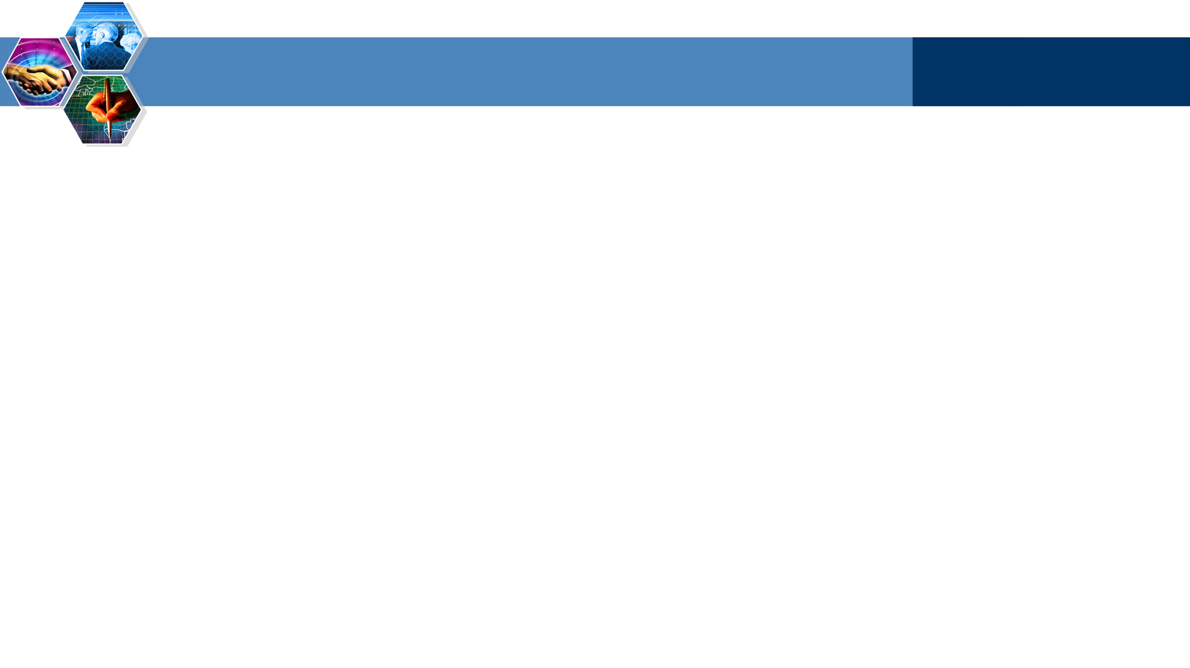
The process of data transfer
Computer 1
Computer 2
AP₁
pass data to the application layer
AP₂
5
add the application head, becomes msg
5
4
4
3
3
2
2
1
1

Slide 14
The process of data transfer
Computer 1
Computer 2
AP₁
AP₂
5
pass the msg to transport layer
5
4
add the transport head
4
3
3
2
2
1
1

Slide 15
The process of data transfer
Computer 1
Computer 2
AP₁
AP₂
5
5
4
pass the segment to network
4
3
add the network head, becomes datagram
3
2
2
1
1

Slide 16
The process of data transfer
Computer 1
Computer 2
AP₁
AP₂
5
5
4
4
3
pass the datagram to the data link layer
3
2
add the link head and tail, becomes frame
2
1
1

Slide 17
The process of data transfer
Computer 1
Computer 2
AP₁
AP₂
5
5
4
4
3
3
2
pass the frame to the physical layer
2
1
physical layers passes the bit stream to the media
1

Slide 18
The process of data transfer
Computer 1
Computer 2
AP₁
AP₂
5
5
4
4
3
3
2
electronic signal is transmitted in physical media
from the sender PHY to the receiver PHY
2
1
1
physical media

Slide 19
The process of data transfer
Computer 1
Computer 2
AP₁
AP₂
5
5
4
4
3
3
2
the physical layer receives the bit stream,
and hands over frame to the above data link layer
2
1
1

Slide 20
The process of data transfer
Computer 1
Computer 2
AP₁
AP₂
5
5
4
4
3
3
data link layer picks out the datagram and
hands over to the network layer
2
2
1
1

Slide 21
The process of data transfer
Computer 1
Computer 2
AP₁
AP₂
5
5
4
4
network layer picks out the segment and
hands over to the transport layer
3
3
2
2
1
1

Slide 22
The process of data transfer
Computer 1
Computer 2
AP₁
AP₂
5
5
transport layer picks out the msg and
hands over to the application layer
4
4
3
3
2
2
1
1

Slide 23
The process of data transfer
Computer 1
Computer 2
AP₁
AP₂
application layer picks out the data and
hands over to the application
5
5
4
4
3
3
2
2
1
1

Slide 24
The process of data transfer
Computer 1
I received the data
sent by AP1！
Computer 2
AP₁
AP₂
5
5
4
4
3
3
2
2
1
1

Slide 25
The process of data transfer
Computer 1
Computer 2
AP₁
app head
application data
AP₂
5
trans head
5
H₅
application data
net head
4
H₄
H₅
application data
4
link
head
link
tail
3
H₃
H₄
H₅
application data
3
2
H₂
H₃
H₄
H₅
application data
T₂
2
1
10100110100101 bit stream 110101110101
1

Slide 26
The process of data transfer
Computer 1
Computer 2
AP₁
AP₂
5
5
4
4
After receiving the bit stream, the physical layer
of computer 2 hands it over to the link layer
3
3
2
H₂
H₃
H₄
H₅
application data
T₂
2
1
10100110100101 bit stream 110101110101
1

Slide 27
The process of data transfer
Computer 1
Computer 2
AP₁
AP₂
5
5
After removing the head and tail of the frame, link
Layer hands over the data to the network layer.
4
4
3
H₃
H₄
H₅
application data
3
2
H₂
H₃
H₄
H₅
application data
T₂
2
1
1

Slide 28
The process of data transfer
Computer 1
Computer 2
AP₁
AP₂
After removing the head, the network layer
hands over the data to the transport layer.
5
5
4
H₄
H₅
application data
4
3
H₃
H₄
H₅
application data
3
2
2
1
1

Slide 29
The process of data transfer
Computer 1
After removing the head, the transport layer
hands over the data to the application layer.
Computer 2
AP₁
AP₂
5
H₅
application data
5
4
H₄
H₅
application data
4
3
3
2
2
1
1

Slide 30
The process of data transfer
Computer 1
Computer 2
AP₁
application data
AP₂
5
H₅
application data
5
4
After removing the head, the application layer
hands over the data to the application.
4
3
3
2
2
1
1

Slide 31
The process of data transfer
Computer 1
I received the data
sent by AP1！
Computer 2
AP₁
AP₂
5
5
4
4
3
3
2
2
1
1

Slide 32
Encapsulation
source
message
M
application
transport
network
link
physical
segment
H_{t}
M
H_{t}
datagram
H_{n}
H_{n}
H_{t}
M
frame
H_{l}
H_{n}
H_{t}
M
link
physical
switch
destination
H_{n}
H_{t}
M
network
link
physical
M
application
transport
network
link
physical
H_{l}
H_{n}
H_{t}
M
H_{n}
H_{t}
M
H_{t}
M
H_{n}
H_{t}
M
H_{l}
H_{n}
H_{t}
M
router

Slide 33
Functions of each layer
physical layer
establish, maintain and release physical connection between two entities of data link layer.
bit
prescribe the electronic parameter of the physical layer.
prescribe the connector
To transfer bit stream

Slide 34
Functions of each layer
data link
establish, maintain and release data link, show a right link to the network layer
frame
dividing and synchronization of frames
error detection and control
access control
To transfer data from one node to its adjacent node

Slide 35
Functions of each layer
network
forwarding
datagram
routing
Host-to-host data transmission

Slide 36
Functions of each layer
transport
provide logical communication between app processes
segment
error control
sequence control
flow control
Process-to-Process (end2end) data transmission

Slide 37
Functions of each layer
application
message
provide interface for users

Slide 38
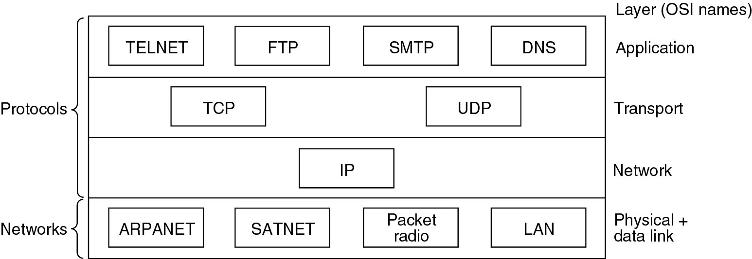
Protocols and networks
Protocols and networks in the TCP/IP model initially.

Slide 39

Summary
Protocol layers
Service models

